Slide 1

4. Clustering and batch correction of scRNAseq
Jose Alejandro Romero Herrera
2021/12/02

Slide 2
Agenda. Postprocessing
Quality control
Dimensionality reduction and Visualization
R language-Seurat
Clustering
Batch correction
DEG analysis
GREAT, PANTHER, GOrilla, DAVID
GO-term and pathway analysis
Diffusion maps/Slingshot
Pseudotime
Notes:
Glossary of single cell terms: https://nbisweden.github.io/single-cell-pbl/glossary_of_terms_single_cell.html
R language: https://www.r-project.org/ https://rstudio.com/
Seurat: https://satijalab.org/seurat/
GREAT: http://great.stanford.edu/public/html/
PANTHER: http://www.pantherdb.org/
GOrilla: http://cbl-gorilla.cs.technion.ac.il/
DAVID: https://david.ncifcrf.gov/
Diffusion maps: https://www.sciencedirect.com/science/article/pii/S1063520306000546
Slingshot: https://bmcgenomics.biomedcentral.com/articles/10.1186/s12864-018-4772-0

Slide 3
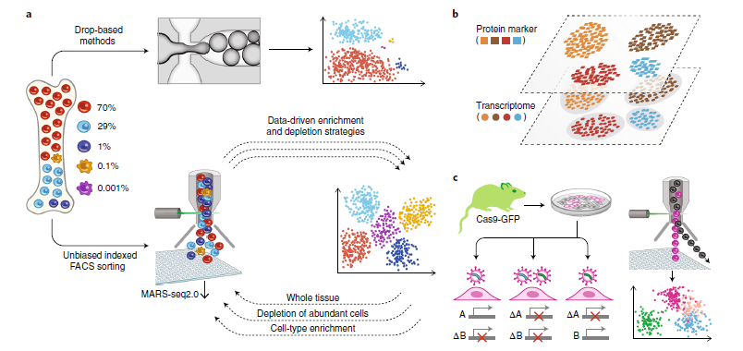
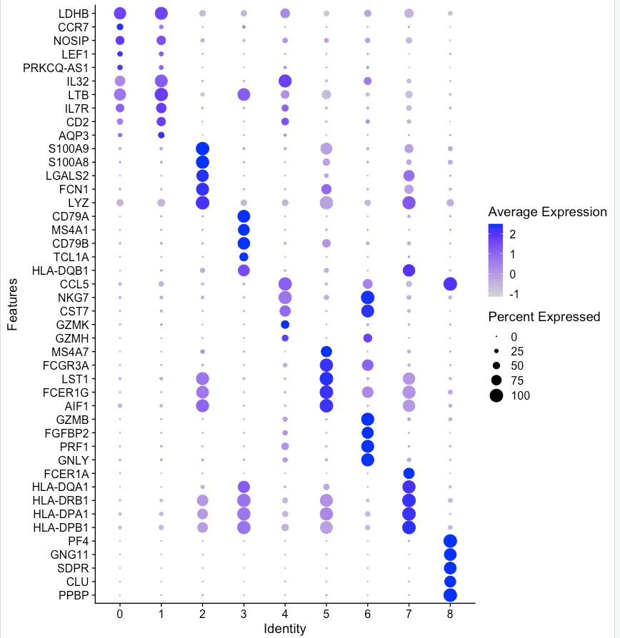
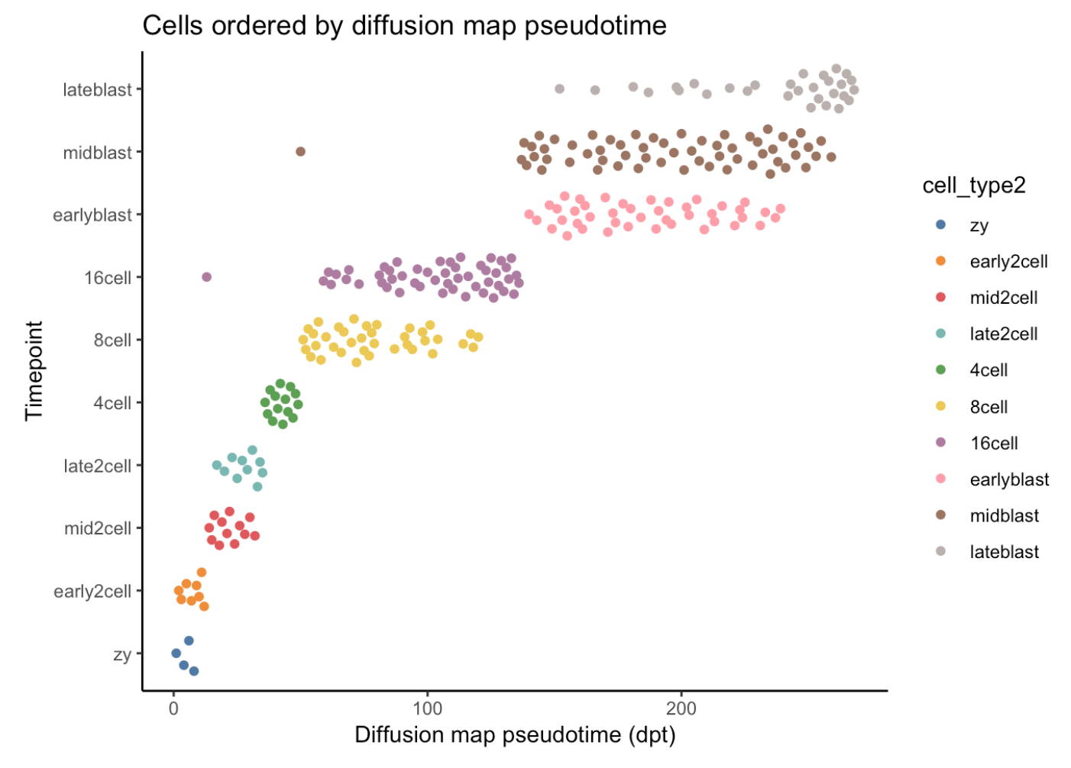
Workflow
Batch correction
QC
SC experiment
DE
Enrichment analysis
Clustering
Dimensionality reduction
Visualization
Pseudotime

Slide 4
Dimensionality reduction and Visualization
Selection of High Variable Genes (HVG)
Dimensionality reduction methods
PCA
t-SNE
UMAP
Visualization
Notes:
t-SNE: http://www.jmlr.org/papers/volume9/vandermaaten08a/vandermaaten08a.pdf
UMAP: https://umap-learn.readthedocs.io/en/latest/

Slide 5

Selection of HVGs
Single cell data is heterogenous
Different groups of cells will have different expression patterns
Genes with different patterns will show higher Variance*
(*or standard deviation)
Higher variance = different patterns = more information about the cells
Selection of most variable genes will reduce computational times

Slide 6
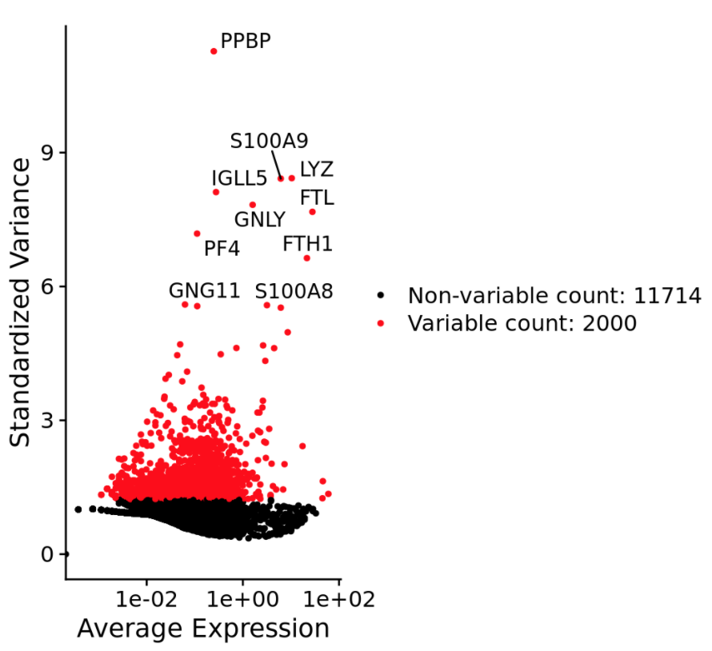
Selection of HVGs
Use around 2000 or 1000 genes
DE analysis should still be done for all genes
Exceptions may be made if your computer is too slow!

Slide 7
Dimensionality Reduction
A read count matrix is huge! Several thousands of genes/variables
We cannot visualize cells this way: humans can only see in 2d/3d
With dimensionality reduction, we can “compress” gene expression matrix into a 2 dimensions object that will contain most of the information

Slide 8

Dimensionality Reduction
Principal Component of a 2D space

Slide 9
Dimensionality Reduction
Three main methods.
PCA
t-SNE
UMAP. Practically the norm for single cell RNAseq
Cells can be visualized in 2 or 3 dimensions, instead of thousands of gene expression variables

Slide 10
Dimensionality Reduction

Slide 11
Clustering
The task of dividing cells into several homogeneous groups that are dissimilar between each other.
Different types of clustering
Community detection
Density
Clustering is based on PCA reduction
t-SNE and UMAP are used mostly for visualization.

Slide 12
Clustering

Slide 13
Batch correction
Doing sequencing runs at different times (batches) or integrating experiments from different technologies will produce confounding factors
Cells that are supposed to be “identical” will form different clusters

Slide 14
Batch correction
There are several mathematical models that try to correct this effect
Tools: limma (removeBatchEffect), Seurat integration tools, K-NN

